Slide 1

Object Detection Using Video Surveillance Camera
GRAPHIC ERA DEEMED UNIVERSITY
Presenter: Jai Yadav
Btech CSE
Semester-III
Under the mentorship of
Pawan Kumar Mishra
Assistant Professor

Slide 2
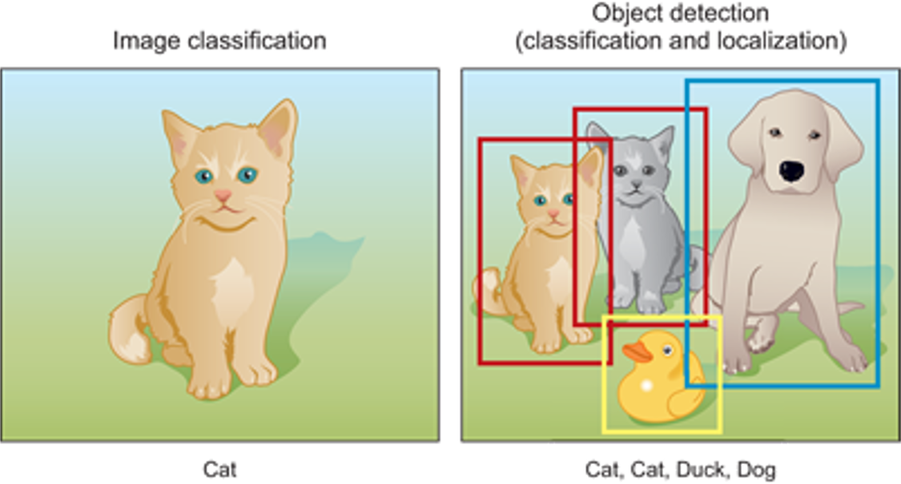
Problem Addressed: Object Detection
Object detection is the problem of both locating AND classifying objects
Goal of YOLO algorithm is to do object detection both fast AND with high accuracy
Object Detection vs Classification

Slide 3
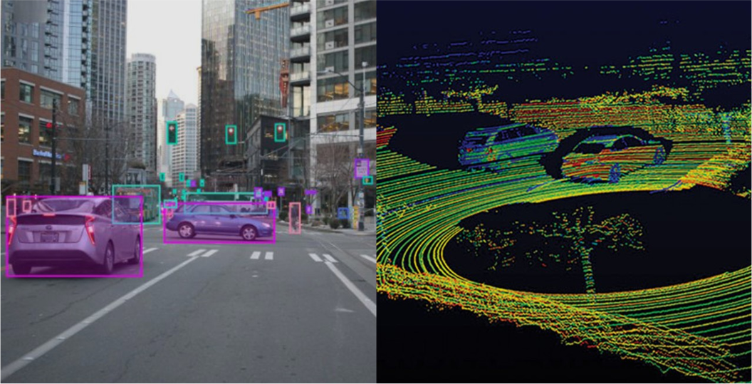
Importance of Object Detection
Visual modality is very powerful
Humans are able to detect objects and do perception using just this modality in real time (not needing radar)
If we want responsive robot systems that
work in real time (without specialized sensors) almost real time vision based object detection can help greatly
Vision based vs LIDAR (self driving)
3

Slide 4
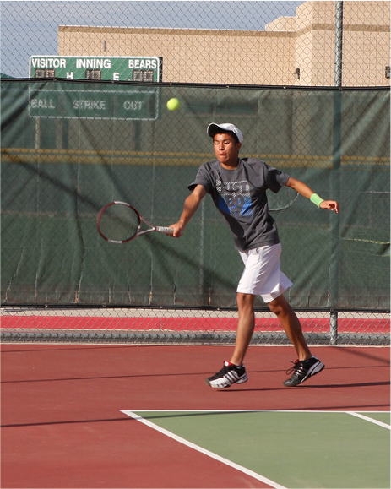
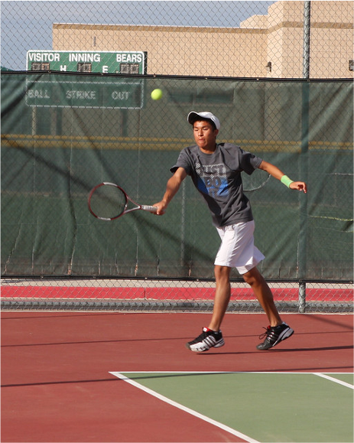
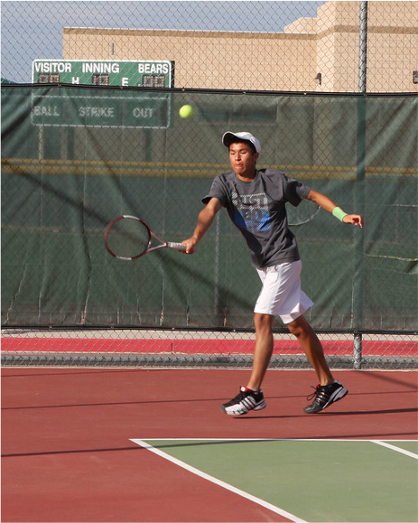
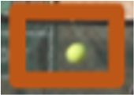
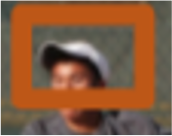
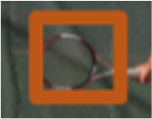
Previous Object Detection Paradigm
This pipeline was used in nearly all SOTA Object Detection prior:
Label + confidence
Image Classifier
hat - 0.92
racket - 0.2
ball - 0.23
Step 1: Scan the image to generate candidate bounding boxes
Step 2: Run the bounding box through a classifier
Step 3: Conduct post-processing (filtering out redundant bounding boxes)

Slide 5
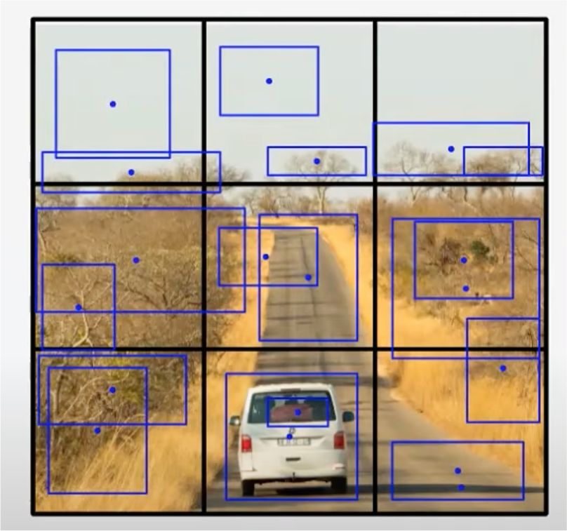
YOLO overview
First, image is split into a SxS grid
For each grid square, generate B bounding boxes
For each bounding box, there are 5 predictions: x, y, w, h, confidence
S = 3, B = 2

Slide 6
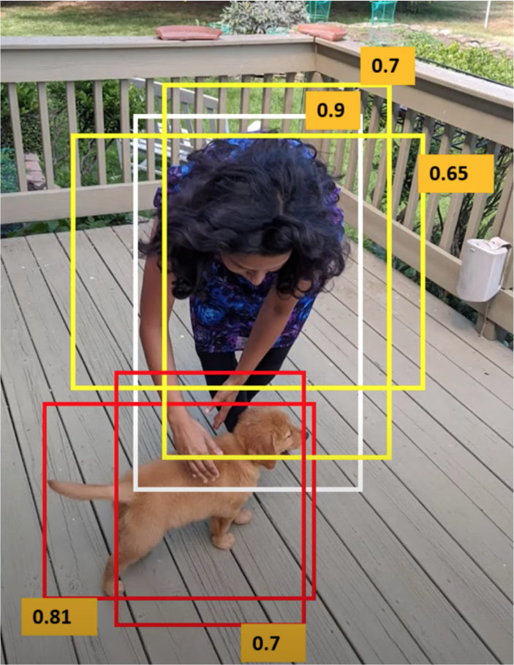
Non-maximal suppression
Most of the time objects fall in one grid, however it is still possible to get redundant boxes (rare case as object must be close to multiple grid cells for this to happen)
Discard bounding box with high overlap (keeping the bounding box with highest confidence)
Adds 2-3% on final mAP score

Slide 7
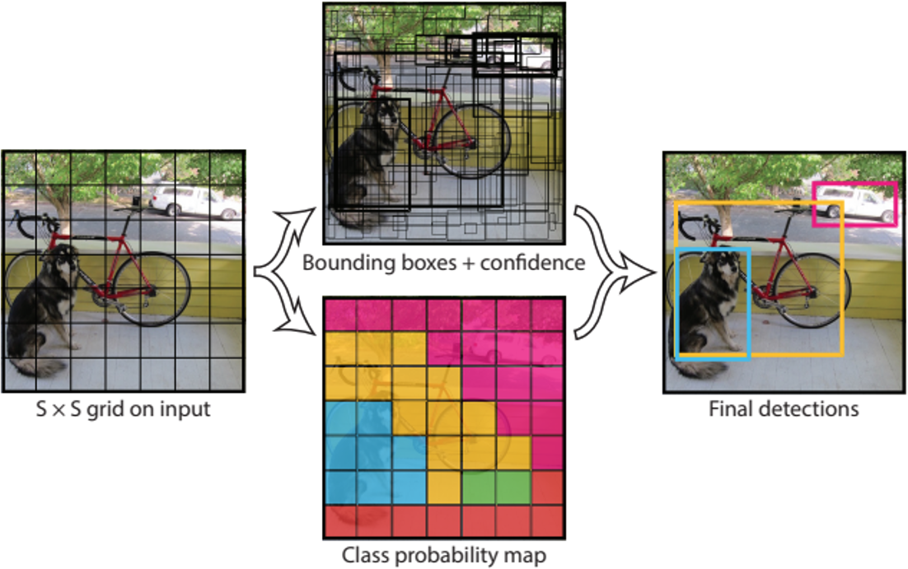
YOLO Prediction
We then use the output to make final detections
Use a threshold to filter out bounding boxes with low P(Object)
In order to know the class for the bounding box compute score take argmax over the distribution Pr(Class|Object) for the grid the bounding box’s center is in

Slide 8
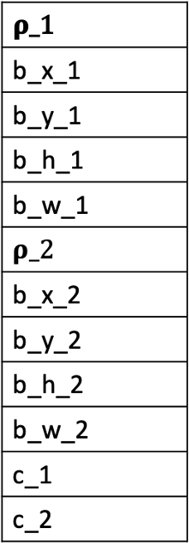
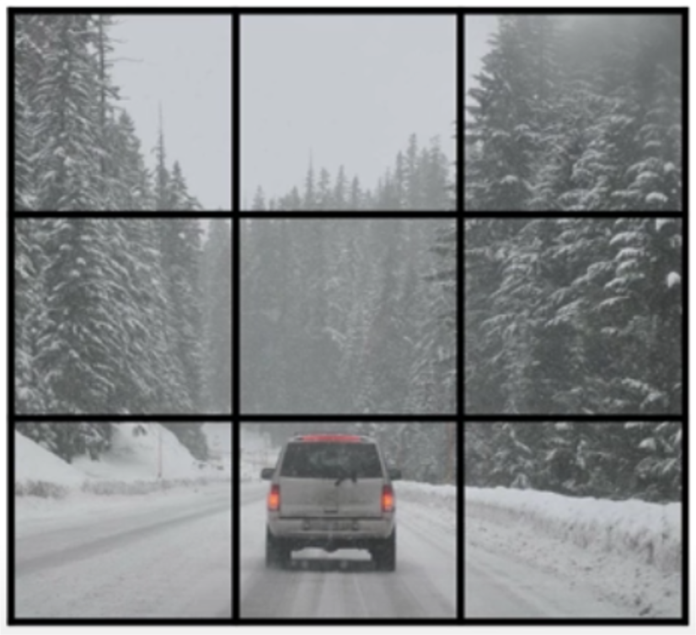
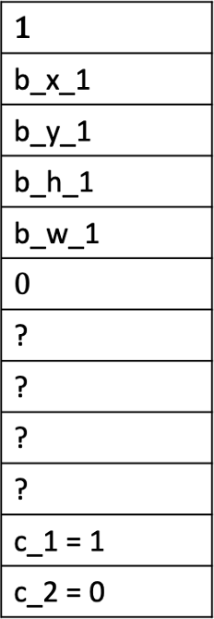
For each grid block, we have a vector like this. For this example B is 2 and C is 2
YOLO Training
YOLO is a regression algorithm. What is X? What is Y?
X is simple, just an image width (in pixels) * height (in pixels) * RGB values
Y is a tensor of size S * S * (B * 5 + C)
B*5 + C term represents the predictions
+ class predicted distribution for a grid block
label example:

Slide 9
Methedology Used
Taking Video frames as Input
Initializing YOLO object model
Getting Confidence Scores
Creating Bounding Boxes
Display it on separate windows
Repeat
Plot the bar graph along the video

Slide 10
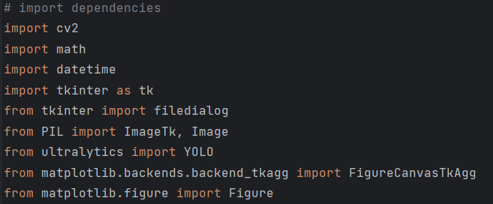
Libraries Included:

Slide 11
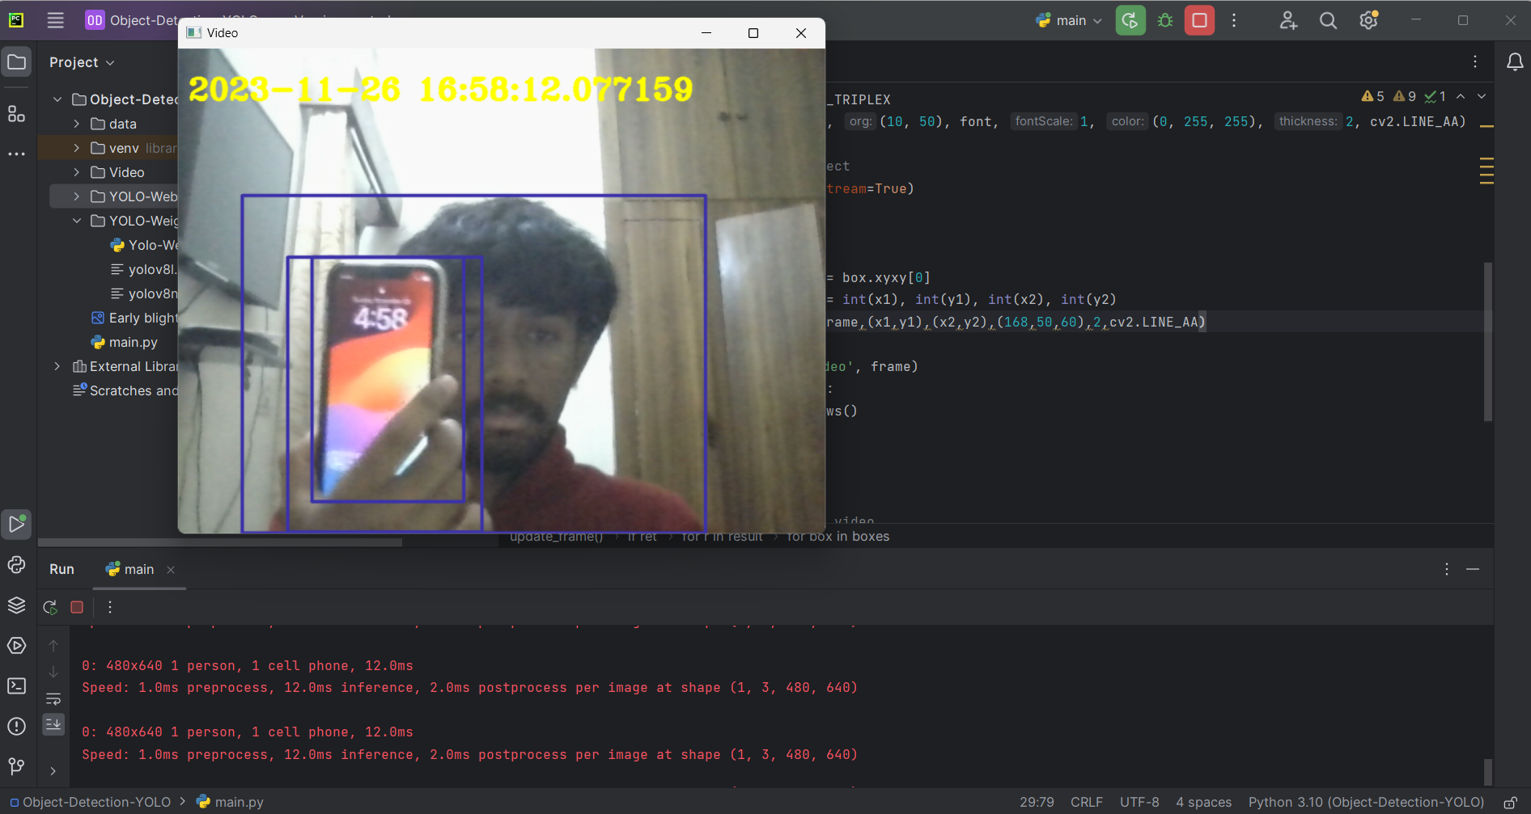
Initial Bounding Boxes using YOLO predefined Weights

Slide 12
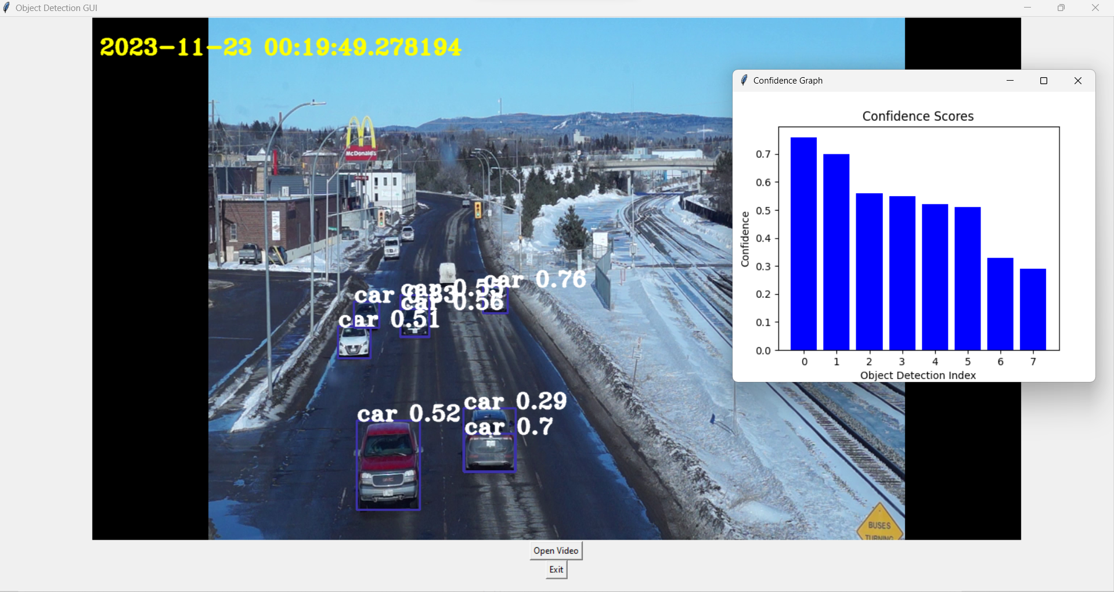
Output of the algorithm:

Slide 13
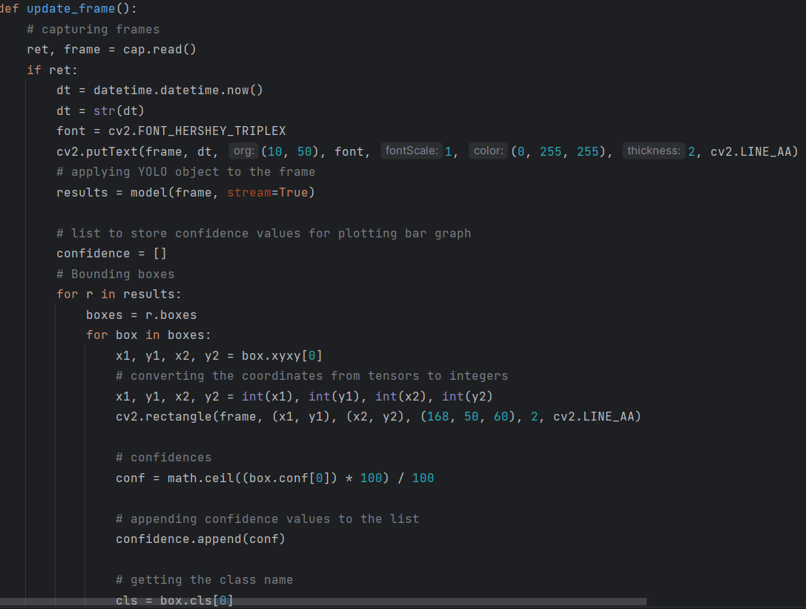
CODE SNIPPET:
BOUNDING BOXES

Slide 14
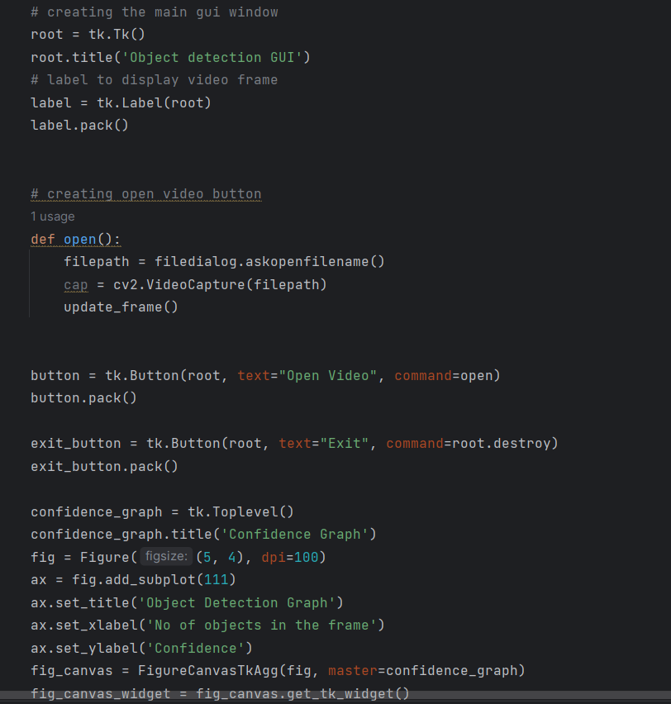
GUI:

Slide 15
Related Work
R-CNN or Region Based Convolutional Network (Girshick et al. 2014):
Used the sliding window approach from earlier, with Selective Search, a smarter way to select candidates (which means there is less computation)
Still feeds a limited part of the image to the classifier
Drawbacks: Large pipeline, slow, too many false positives
Fast and Faster R-CNN:
Optimize parts of the pipeline described earlier
Drawbacks: loses accuracy
Deep Multibox (Szegedy et. al 2014):
Train a CNN to find areas of interest
Drawbacks: Doesn’t address classification only localization
MultiGrasp (Redmon et. al 2014)
Similar to YOLO
A much simpler task (only needs to predict object not multiple objects)

Slide 16
Discussion of Results
Pro: YOLO is a lot faster than the other algorithms for image detection
Pro: YOLO’s use of global information rather than only local information allows it to understand contextual information when doing object detection
Does better in domains such as artwork due to this
Con: YOLO lagged behind the SOTA models in object detection
This is attributed to making many localization errors and unable to detect small object

Slide 17
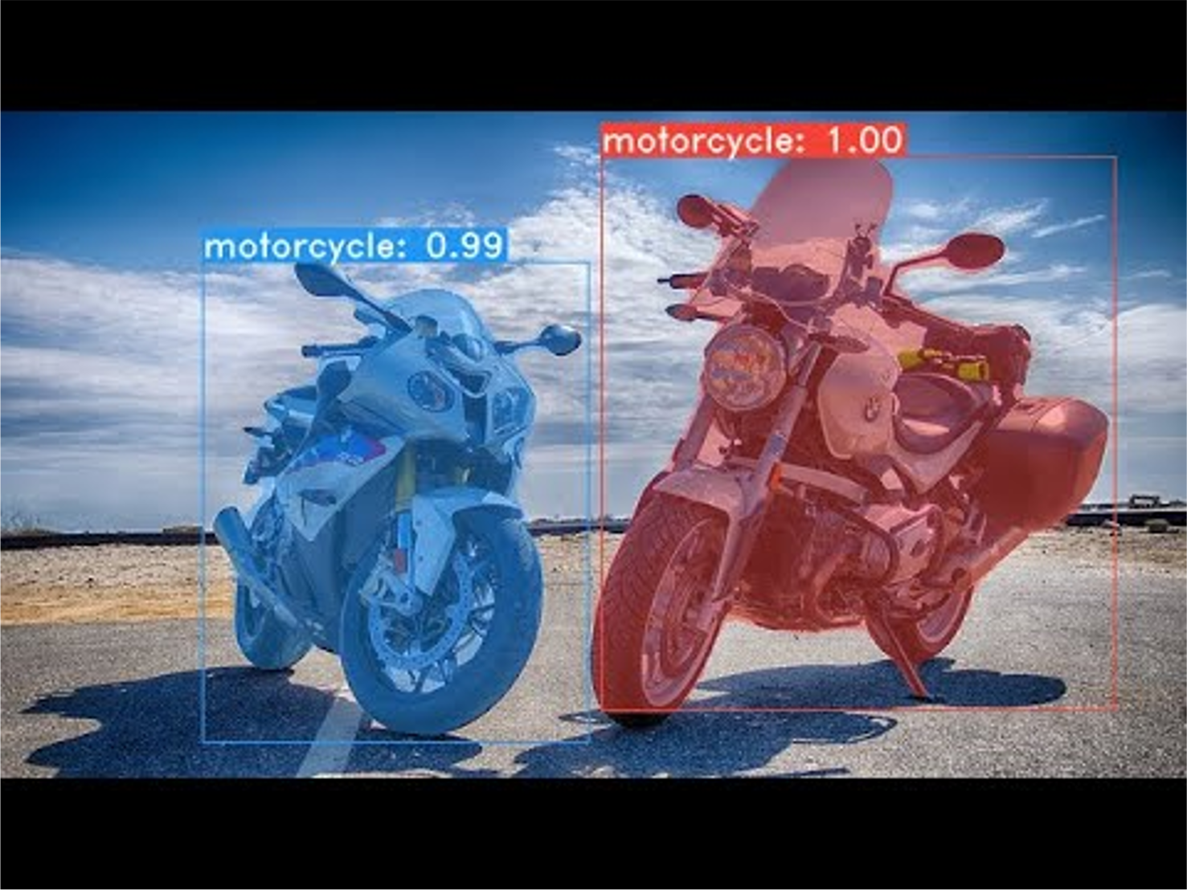
Future Work
One extension of this work would be to look at image segmentation and see if the insights carry over
YOLOACT (Boyla et al 2019): Real time image segmentation
YOLO has been upgraded 8 times
Solves a lot of issues relating to detecting small objects,
generalizability, and localization
YOLOACT example

Slide 18
Summary
Object detection is the problem of detecting multiple objects in an image
Almost real time object detection can make highly responsive robot systems without complex sensors
Prior work relies on a large architecture with numerous parts to optimize
YOLO proposes a unified architecture, which does all the tasks in one model and by one inference over the entire image
They show enormous speed improvement and show that they can beat most other prior work in terms of mAPs

